Slide 1
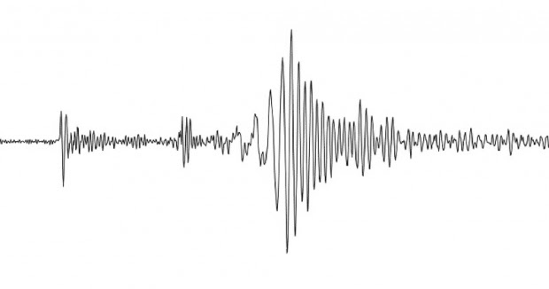
It’s All My Fault!
California Earthquakes: Lesson 1
This Photo by Unknown Author is licensed under CC BY-NC-ND

Slide 2
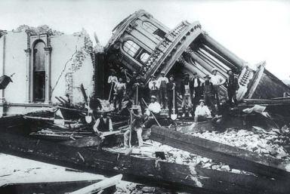
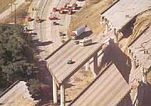
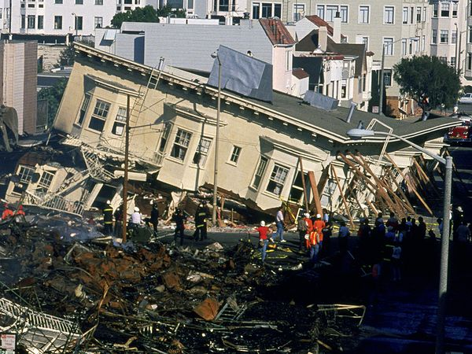
Earthquake!
What exactly is an earthquake?
This Photo by Unknown Author is licensed under CC BY-SA
This Photo by Unknown Author is licensed under CC BY-NC-SA
This Photo by Unknown Author is licensed under CC BY-NC-SA

Slide 3
It all starts inside Earth. What is our planet made of?
This Photo by Unknown Author is licensed under CC BY

Slide 4
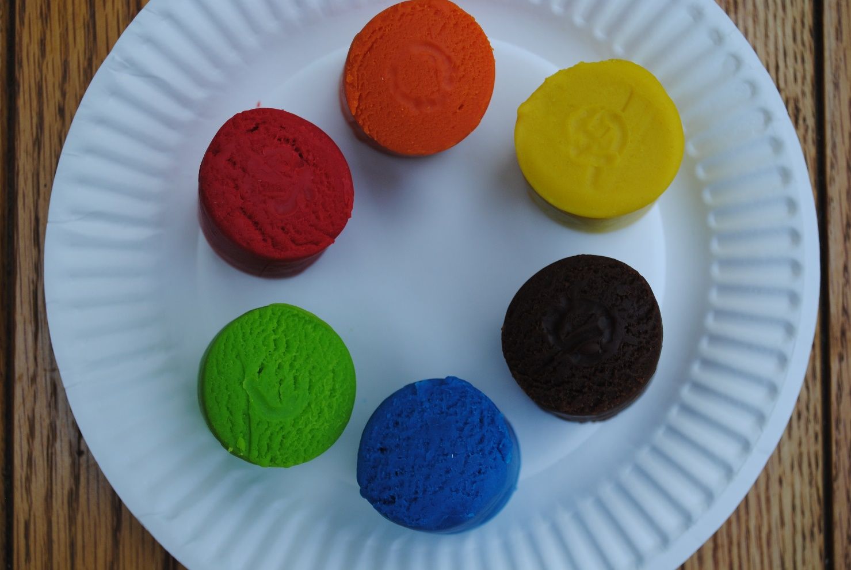
Let’s explore the inside of Earth!
Here are the materials you will need.
Red modeling compound
Orange modeling compound
Yellow modeling compound
Brown modeling compound
Blue modeling compound
Green modeling compound

Slide 5
Use the red modeling compound. Make a small ball.
This ball represents the Inner Core of the Earth. Scientists believe the Inner Core is a solid ball of mostly iron and nickel.

Slide 6
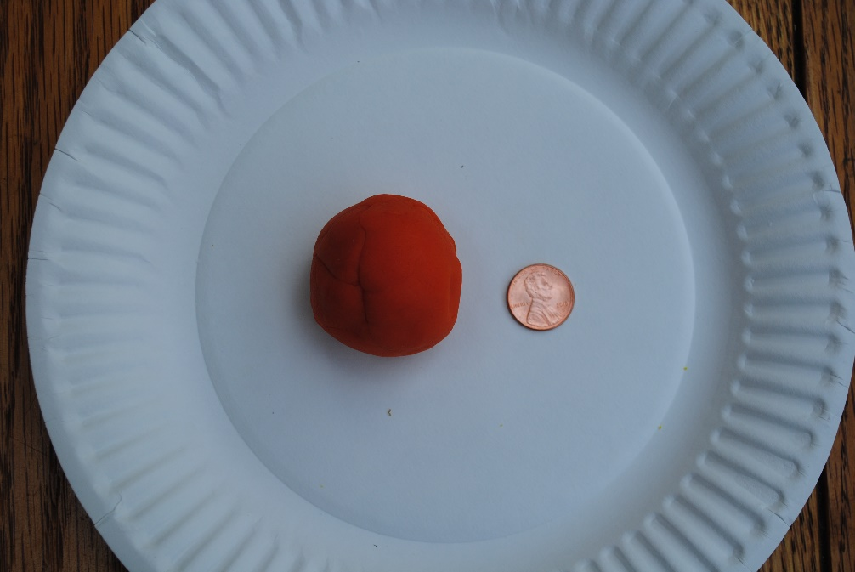
Use the orange modeling compound. Wrap a thick layer around the Inner Core.
This layer represents the Outer Core. Scientists believe the Outer Core is made of super-heated liquid molten lava. This lava is believed to be mostly iron and nickel.

Slide 7
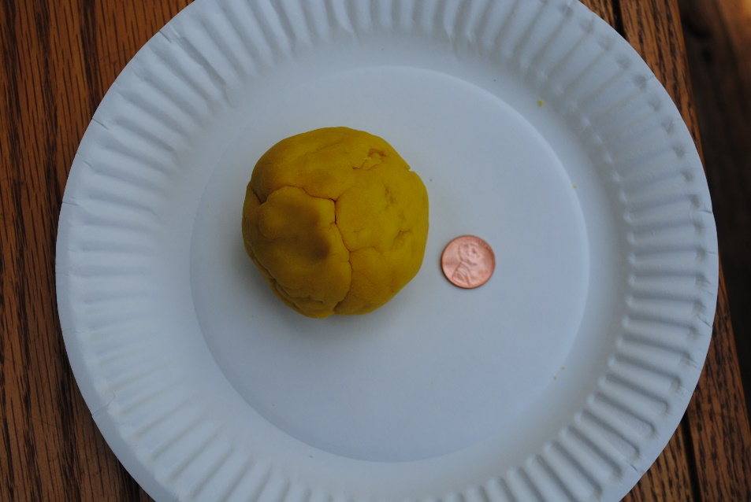
Use the yellow modeling compound. Wrap a thick layer around the Outer Core.
This layer represents the Mantle. Scientists believe the Mantle is super-hot, thick, liquid rock.

Slide 8
Use the brown modeling compound. This time put large, thin pieces over the Mantle with cracks in between.
This layer represents the Crust. The Crust layer is made of pieces of solid rock that float on the Mantle.

Slide 9
Use the blue modeling compound. Put thin, large pieces over some of the Crust.
This represents our oceans. Oceans cover 70 percent of our Earth.

Slide 10
Use the green modeling compound. Cover the exposed Crust pieces with thin pieces.
This represents land on Earth. Land makes up 30 percent of our planet.

Slide 11
Now let’s cut our model of the Earth in half!
Use dental floss to slice your model. Take a look at the layers of the Earth. Can you name each layer and tell what it is made of?
Click here for a video of this activity:
https://www.youtube.com/watch?v=K9vtd4PLCDI

Slide 12
Earth has many layers.
The crust is the hard layer we walk on.
It floats on the mantle, which is a hot, thick, liquid layer.
The crust is made of many plates, which are constantly moving very slowly.
This Photo by Unknown Author is licensed under CC BY
This Photo by Unknown Author is licensed under CC BY-SA
This Photo by Unknown Author is licensed under CC BY-SA

Slide 13
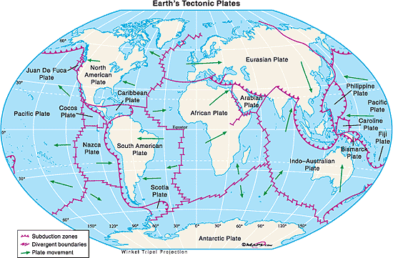
Which plates are nearest to California?
This Photo by Unknown Author is licensed under CC BY-SA

Slide 14
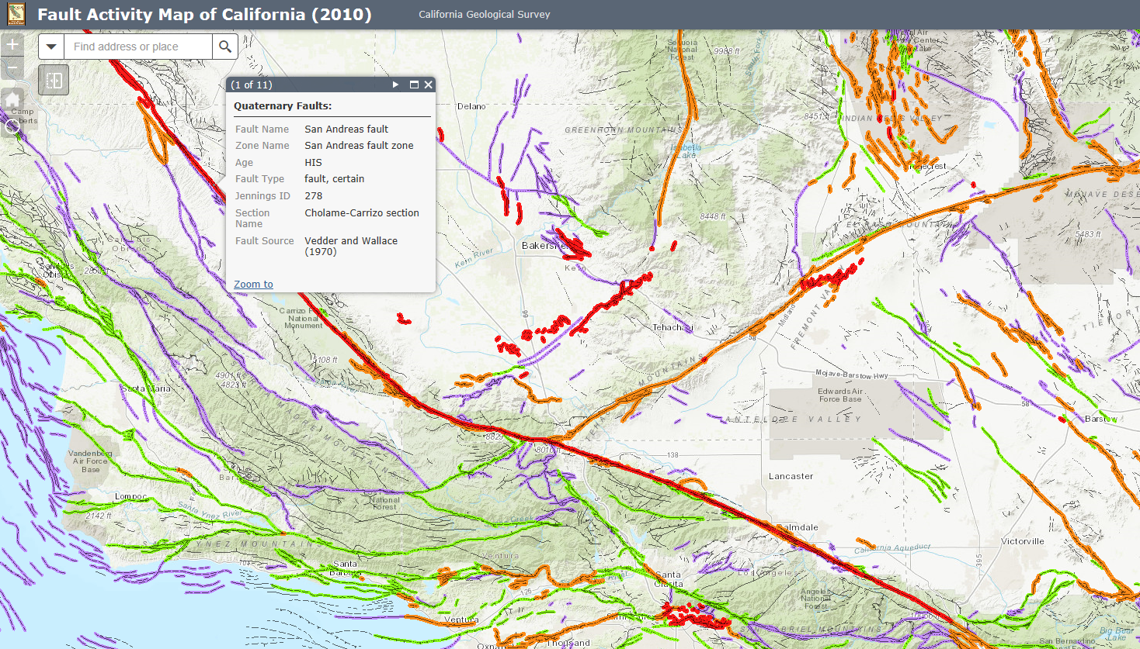
The San Andreas Fault is one location where there is movement in the North American and Pacific plates. Remember, the crust layer floats on the mantle.
You can look at a map to find the San Andreas Fault. Click here to access the map and zoom in on the fault in red. Fault Map of California
This Photo by Unknown Author is licensed under CC BY-NC-ND

Slide 15
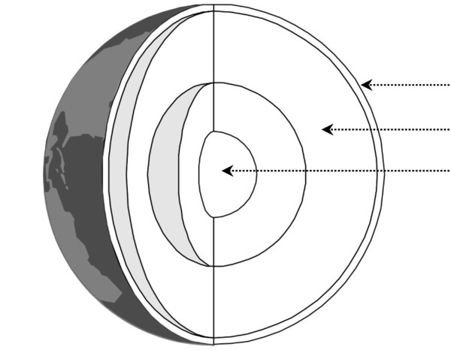
What have we learned about the layers of the Earth? Can you label the layers and describe what scientists think they are made of?
This Photo by Unknown Author is licensed under CC BY-ND

Slide 16
conservation.ca.gov
maps.conservation.ca.gov

